Slide 1
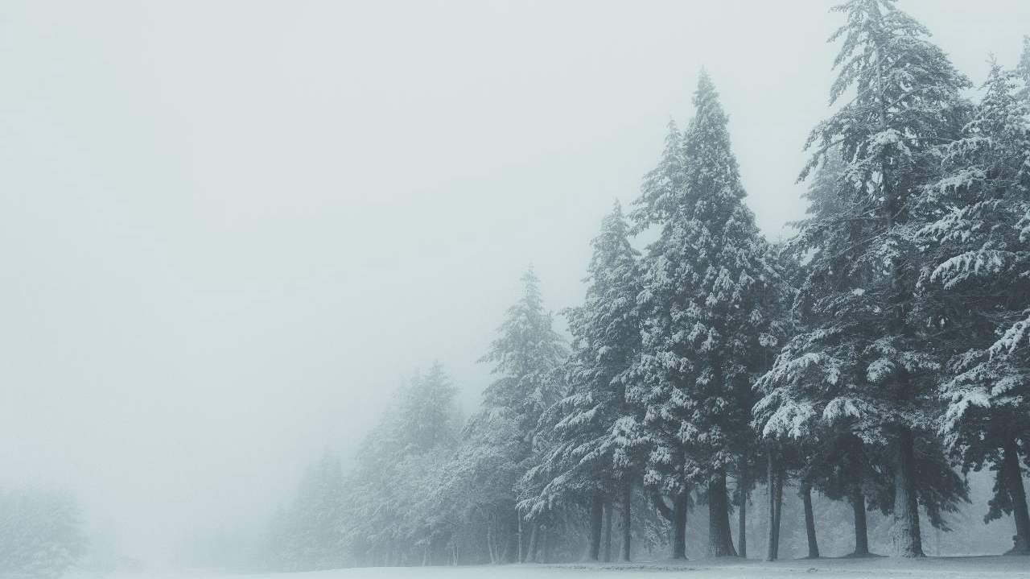

VALLEY.
Maecenas porttitor congue massa.
SNOWBERG
CEDAR
Pellentesque habitant morbi tristique senectus et netus et malesuada fames ac turpis egestas. Proin pharetra nonummy pede. Mauris et orci.

Slide 2
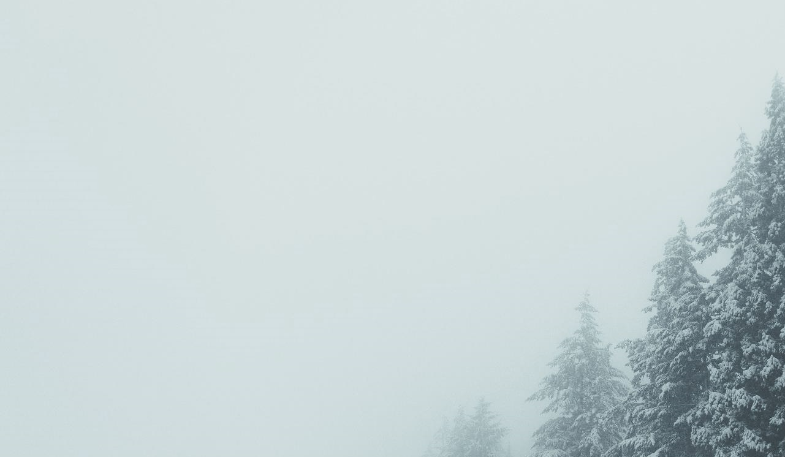
TEXT HERE
01
Copy paste fonts. Choose the only option to retain text.
TEXT HERE
02
Copy paste fonts. Choose the only option to retain text.
CONTENTS
TEXT HERE
03
Copy paste fonts. Choose the only option to retain text.
TEXT HERE
04
Copy paste fonts. Choose the only option to retain text.

Slide 3

01
YOUR TITLE HERE
Pellentesque habitant morbi tristique senectus et netus et malesuada fames ac turpis egestas. Proin pharetra nonummy pede. Mauris et orci.

Slide 4

REPORT & DESIGN
Maecenas porttitor congue massa.
01
CEDAR
The Naïve Collection is a beautifully simple furniture collection comprising chairs, stools, and tables. Designed by Lithuanian duo Inesa Malafej and Arūnas Sukarevičius and produced by home accessory company , this series was born as an extension of the first of the Naïve pieces—the Chair.

Slide 5
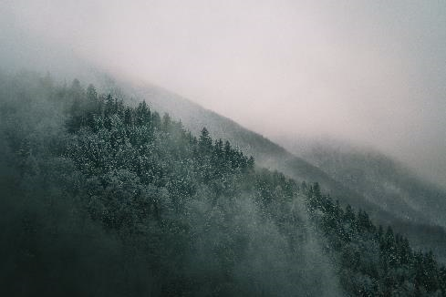
WIDELY USE
Cedrus trees can grow up to 30–40 m (occasionally 60 m) tall with spicy-resinous scented wood, thick ridged or square-cracked bark, and broad, level branches. The shoots are dimorphic, with long shoots, which form the framework of the branches, and short shoots, which carry most of the leaves.
REPORT & DESIGN
Maecenas porttitor congue massa.
Cedar wood and cedar oil are known to be a natural repellent to moths,[16] hence cedar is a popular lining for modern-day cedar chests and closets in which woolens are stored. This specific use of cedar is mentioned in The Iliad (Book 24),
02

Slide 6
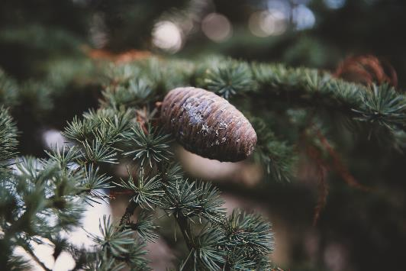
REPORT & DESIGN
Maecenas porttitor congue massa.
E
03
COLOGY
Being the youngest member of the Naïve family, the Naïve Low Chair introduces itself with a bright
Being the youngest member of the Naïve family, the Naïve Low Chair introduces itself with a bright
Being the youngest member of the Naïve family, the Naïve Low Chair introduces itself with a bright

Slide 7
02
YOUR TITLE HERE
Pellentesque habitant morbi tristique senectus et netus et malesuada fames ac turpis egestas. Proin pharetra nonummy pede. Mauris et orci.

Slide 8
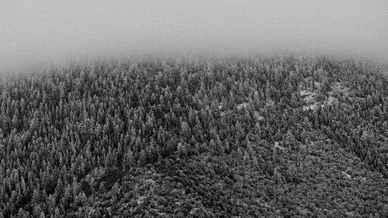
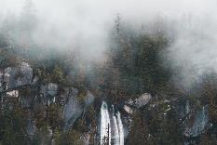

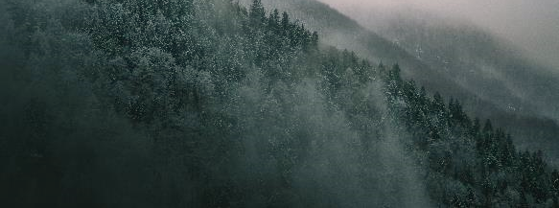
In North America, species of the genus Thuja, such as western red cedar, are commonly — though mistakenly — confused with genuine cedar, as is J. virginiana, typically known as red cedar or eastern red cedar.
REPORT & DESIGN
Maecenas porttitor congue massa.
ETYMOLOGY
04

Slide 9
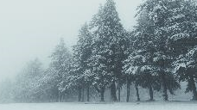
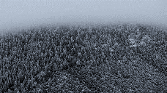
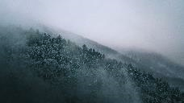
REPORT & DESIGN
Maecenas porttitor congue massa.
05
TEXT HERE
2017
Cone maturation takes one year, with pollination in autumn and the seeds maturing the same time a year later. The pollen cones are slender ovoid, 3–8 cm long, produced in late summer.
TEXT HERE
2017
Cone maturation takes one year, with pollination in autumn and the seeds maturing the same time a year later. The pollen cones are slender ovoid, 3–8 cm long, produced in late summer.
TEXT HERE
2017
Cone maturation takes one year, with pollination in autumn and the seeds maturing the same time a year later. The pollen cones are slender ovoid, 3–8 cm long, produced in late summer.

Slide 10

TEXT HERE
YOU TITLE HERE
Copy paste fonts. Choose the only option to retain text.
Species of both genera are native to the area where Greek language and culture originated, though as the word kédros does not seem to be derived from any of the languages of the Middle East.
REPORT & DESIGN
Maecenas porttitor congue massa.
TEXT HERE
Copy paste fonts. Choose the only option to retain text.
06
TEXT HERE
Copy paste fonts. Choose the only option to retain text.

Slide 11
03
YOUR TITLE HERE
Pellentesque habitant morbi tristique senectus et netus et malesuada fames ac turpis egestas. Proin pharetra nonummy pede. Mauris et orci.

Slide 12
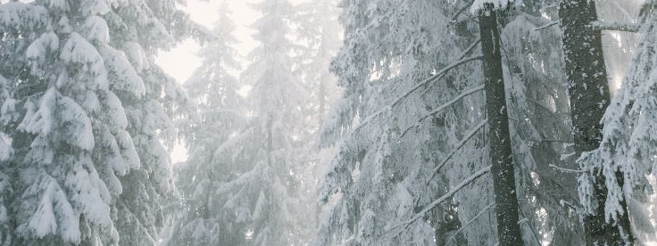
REPORT & DESIGN
Maecenas porttitor congue massa.
07
CADER
DECRICPTION
Both the Latin word cedrus and the generic name cedrus are derived from Greek κέδρος kédros. Ancient Greek and Latin used the same word, kédros and cedrus, respectively, for different species of plants now classified in the genera Cedrus and Juniperus (juniper).

Slide 13

REPORT & DESIGN
Maecenas porttitor congue massa.
08
TAXONOMY
Cedrus trees can grow up to 30–40 m (occasionally 60 m) tall with spicy-resinous scented wood, thick ridged or square-cracked bark, and broad, level branches. The shoots are dimorphic, with long shoots, which form the framework of the branches, and short shoots, which carry most of the leaves.

Slide 14
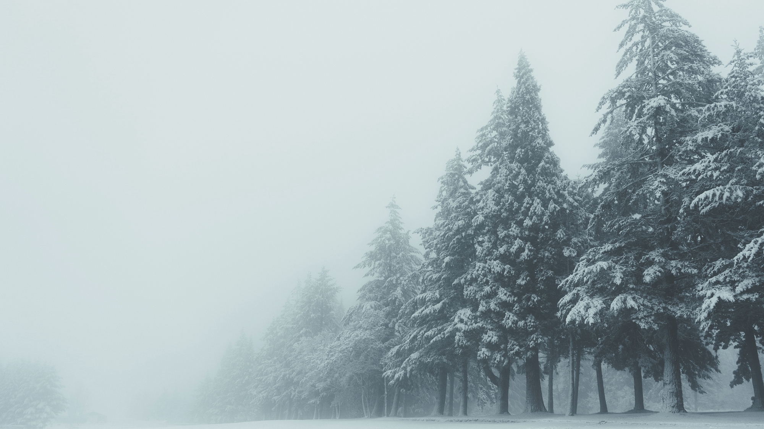
REPORT & DESIGN
Maecenas porttitor congue massa.
09
SPECIES AND
SUBSPECIES
The seed cones are barrel-shaped, 6–12 cm long and 3–8 cm broad, green maturing grey-brown, and, as in Abies, disintegrate at maturity to release the winged seeds. The seeds are 10–15 mm long, with a 20–30 mm wing; as in Abies, the seeds have two or three resin blisters, containing an unpleasant-tasting resin, thought to be a defence against squirrel predation.

Slide 15
04
YOUR TITLE HERE
Pellentesque habitant morbi tristique senectus et netus et malesuada fames ac turpis egestas. Proin pharetra nonummy pede. Mauris et orci.

Slide 16
REPORT & DESIGN
Maecenas porttitor congue massa.
10
TEXT HERE
CEDAR
Copy paste fonts. Choose the only option to retain text.
Cedrus (common English name cedar) is a genus of coniferous trees in the plant family Pinaceae (subfamily Abietoideae). They are native to the mountains of the western Himalayas and the Mediterranean region, occurring at altitudes of 1,500–3,200 m in the Himalayas and 1,000–2,200 m in the Mediterranean.
TEXT HERE
Copy paste fonts. Choose the only option to retain text.
TEXT HERE
Copy paste fonts. Choose the only option to retain text.

Slide 17

REPORT & DESIGN
Maecenas porttitor congue massa.
Cedrus trees can grow up to 30–40 m (occasionally 60 m) tall with spicy-resinous scented wood, thick ridged or square-cracked bark, and broad, level branches. The shoots are dimorphic, with long shoots, which form the framework of the branches, and short shoots, which carry most of the leaves.
11
BREVIFOLIA
DEODARA
Species of both genera are native to the area where Greek language and culture originated, though as the word kédros does not seem to be derived from any of the languages of the Middle East.

Slide 18

REPORT & DESIGN
Maecenas porttitor congue massa.
12
SNOWBERG
Cedrus trees can grow up to 30–40 m (occasionally 60 m) tall with spicy-resinous scented wood, thick ridged or square-cracked bark, and broad, level branches. The shoots are dimorphic, with long shoots, which form the framework of the branches, and short shoots, which carry most of the leaves.

Slide 19
VALLEY.
Maecenas porttitor congue massa.
THANKS
Design by 冰河流域

Slide 20
【注意】
本ppt使用的字体为Malgun Gothic和Malgun Gothic semilight款，可以自行搜索字体替换，ppt配合office2019展示效果更佳喔！

